Slide 1
Polypharmacy
Dr.Maryam Niksolat(MD)
Geriatrician
Assistant prefossor of IUMS

Slide 2
case scenario:
A 78-year-old man with a history of hypertension, diabetes, and insomnia has recently experienced two falls. His current medications include:
Glibenclamide
Prazosin
Lorazepam
Metformin
Atrovastatin
ASA

Slide 4
Associations between medication use and falls in older people:
psychoactive medication (benzodiazepine, antidepressant, antipsychotic)
multiple medication use.
use of psychoactive medications leads to a two to threefold increased risk of falls and a twofold increased risk of experiencing a hip fracture.

Slide 5
Results of studies into use of antihypertensive medications have been conflicting and have also highlighted the importance of examining drug classes rather than grouping all antihypertensive medications together.
some classes of antihypertensive agents (angiotensin system blocking medications) are protective against falls but the mechanisms underpinning this effect are unclear.

Slide 6
These findings also need to be interpreted in the context of medication initiation and prescription changes as a time-risk analysis has shown the risk of falls is significantly increased within the 24-hour periods following the initiation of an antihypertensive or change in antihypertensive dose.

Slide 7
Medication associated with falls

Slide 9
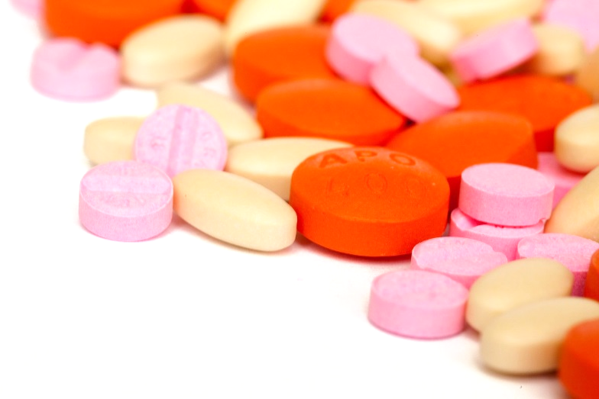
Polypharmacy :
The use of more than 5 medications, some of which may be clinically inappropriate.

Slide 10
co-prescribing multiple medicines increases the risk of adverse events, it is important to note that assigning a numeric threshold to define polypharmacy is not always useful.

Slide 11
The goal should be to reduced inappropriate polypharmacy .

Slide 12
Prevalence:
As much as 25% of the overall population.
• For those >65 years old, prevalence increases to 50%.
• Prevalence may also be dependent on comorbidity.

Slide 13
Appropriate polypharmacy :
(a) all drugs are prescribed for the purpose of achieving specific .therapeutic objectives that have been agreed with the patient
(b) therapeutic objectives are actually being achieved or there is a .reasonable chance they will be achieved in the future
(c) drug therapy has been optimised to minimise the risk of adverse drug reactions (ADRs).
(d) the patient is motivated and able to take all medicines.

Slide 14
Inappropriate polypharmacy :
(a) there is no evidence based indication, the indication has expired
(b) one or more medicines fail to achieve the therapeutic objectives they are intended to achieve
(c) one, or the combination of several drugs cause inacceptable adverse drug reactions (ADRs)
(d) the patient is not willing or able to take one or more medicines as intended.

Slide 15
There are cases where polypharmacy is necessary and beneficial, such as the secondary prevention of myocardial infarction, which requires the use of four different classes of medications (beta blocker, statin, antiplatelet ,an ACE.inhibitor)

Slide 16
Impact of polypharmacy on the older adult
The following risks accompany polypharmacy:
↑ adverse drug reactions
↑ drug interactions
↑ cost
↑ risk of non adherence
↑ risk of medication errors
Precipitate or exacerbate geriatric syndromes

Slide 17
Impact of polypharmacy on the older adult
Geriatric syndromes
Falls
Functional impairment
Cognitive impairment
Urinary incontinence
Impaired nutrition
Dehydration
Constipation

Slide 18
Risk factors for polypharmacy
Multiple medical problems/ multiple medications
Increased risk of
problematic polypharmacy
OR
haramful medication effects
Reduced homeostatic mechanisms and organ dysfunction
Frailty
Acute illness or change to medications
and or

Slide 19
Risk factors for polypharmacy
Pharmacokinetics changes
Changes in how the body acts on the drug
Absorption Distribution Metabolism (liver) Excretion (kidney
Changes in physiology with aging:
↑ body fat ↓ body water ↓ albumin ↓ liver metabolism ↓ renal function
Pharmacodynamics changes
Changes in how the drug acts on the body
Changes in receptor binding ↓ # of receptors and receptor activity ↑↓ Drug efficacy ↑ Toxicity / ADRs

Slide 20
PHARMACOKINETICS
Pharmacokinetics relates to the way the body handles a drug. pharmacokinetics involves:
drug absorption
distribution across body compartments
metabolism in the liver
elimination by the kidneys.
Drug absorption is largely unchanged with aging.
changes in drug distribution, metabolism, and excretion can impact the clearance of a medication from the body in older adults.
Notes:
چهار کلمهٔ جذب٬ توزیع٬ متابولیزم٬ دفع می‌باشد
اثر بدن بر دارو است فاز جذب(Absorption) فرایند ورود و گذشتن دارو از مسیر تجویز شده به درون جریان خون و پلاسما است.

Slide 21
Age-related changes in body composition can affect the volume of distribution of a drug.
older people have less lean body mass and greater fat stores relative to younger people
benzodiazepines that are highly lipid-soluble have an increased volume of distribution and consequently prolonged clearance rates in older people relative to those who are younger.

Slide 22
reduced oxidative metabolism by cytochrome P450 (CYP) enzymes in the liver.
elimination of many drug therapies occurs through renal clearance, and renal function often declines with aging.

Slide 23
PHARMACODYNAMICS
pharmacodynamics relates to the effect that a drug has on the body.
Aging is associated with enhanced sensitivity to a number of drug therapies.
For example, older people may be more sensitive
to the effects of benzodiazepines, opioids, and warfarin, exclusive of any age-related pharmacokinetic changes that might exist .
Notes:
فارماکوکینتیک جنبه‌ای از داروشناسی می‌باشد که به بررسی پارامترهائی چون فراهمی زیستی، کلیرانس، متابولیسم، نیمه‌عمر، حجم توزیع و اثر عبور اوّل داروها می‌پردازد. اغلب فارماکوکینتیک به
چهار کلمهٔ جذب٬ توزیع٬ متابولیزم٬ دفع می‌باشدصورت مزدوج همراه با فارماکودینامیک مطالعه می‌شود. در واقع اولی اثر بدن بر دارو است و دومی اثر دارو بر بدن

Slide 24
risk for fall-related injuries in older patients with use of short–half-life benzodiazepines and zolpidem may actually be similar to that with use of long–half-life benzodiazepines.
clinical factors such as disease, functional status, concomitant medications, nutraceutical intake, and lifestyle may have greater effects and lead to greater variability in drug clearance and effects than based on pure aging.

Slide 25
strategies drug dose for older patients:
weight-based
renal-based dosing
Individualized dosing of renally cleared medications, those with a narrow therapeutic index, is facilitated by the provision of estimates of glomerular filtration rates now routinely added to the results of laboratory panels.

Slide 26
Consequences Adverse Drug Reactions (ADRs) which may include:
Drug-drug interactions
Drug-disease interactions
Drug-food interactions
Drug side effects
Drug toxicity
May increase from 7% in those using 2 drugs to 50% in those using 5 and 100% in those using > 10

Slide 27
Addressing polypharmacy
Assess medication list with an available tool
Explicit criteria – list of potentially inappropriate medications
Implicit criteria or comprehensive assessment
Medication assessment framework

Slide 28
Addressing polypharmacy
“Explicit” approache:
STOPP/START tool
Beers Criteria

Slide 29
Beers criteria:
divided into five lists:
potentially inappropriate medications to avoid in most older adults (these include medications with strong anticholinergic properties, benzodiazepines, and α₁-blockers)
medications to avoid in specific diseases and syndromes
drugs to be used with caution
medications requiring dose adjustment with renal dysfunction
common drug–drug interactions

Slide 30
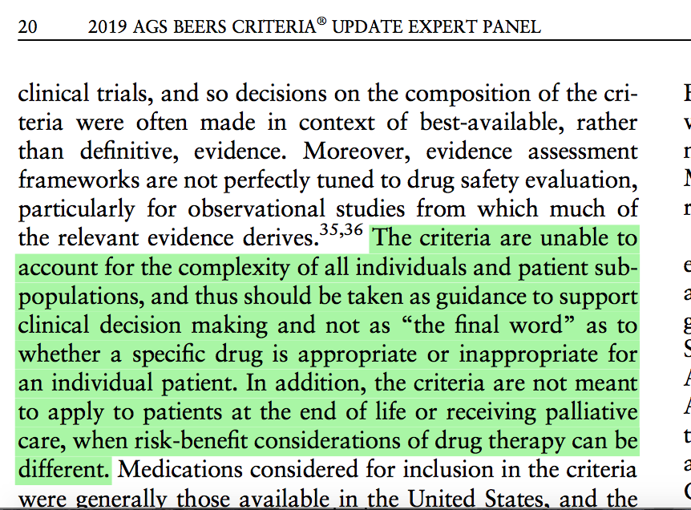
Beers Criteria (AGS 2019) https://nursinghomehelp.org/wp-content/uploads/formidable/17/Panel-2019-Journal_of_the_American_Geriatrics_Society.pdf
Update is more nuanced that previous lists: eg avoid PPIs for more than 8 weeks except for certain high risk patients. Authors caution against strict use:
Includes medicines which:
are potentially inappropriate in most older adults
typically should be avoided in older adults with certain conditions
are for use with caution
have drug-drug interactions
require dose adjustment for kidney function
Notes:
Implications.
https://www.medscape.com/viewarticle/909120
What's Changed?
The 2019 update drops 25 medications or medication classes included in earlier versions because they are no longer available in the United States or because concerns with the drugs are not limited to the older population alone.
Otherwise, the new recommendations do not differ extensively from those of 2015.^{[5]} "That reflects the stability of our recommendations and a maturity in the evidence for many of the drugs," Steinman contended. He did caution, however, that "the literature isn't as robust as we would like for some of these medications."
The rationale for each recommendation, the quality of supporting evidence, and the graded strength of the recommendation are clearly noted. For example, the criteria list 15 first-generation antihistamines as drugs to avoid, noting, among other reasons, that they are highly anticholinergic and that clearance is reduced with advanced age. While the quality of evidence is determined to be moderate, the Beers committee grades the recommendation as strong. Another example: proton-pump inhibitors. These drugs are associated with a risk for Clostridium difficile infection as well as bone loss; evidence is high. But the strong recommendation to avoid is more nuanced, noting that scheduled use for more than 8 weeks should be avoided except for certain high-risk patients.
However, the Beers Criteria are not intended to be taken as gospel. In an accompanying editorial,^{[6]} Steinman and his AGS panel co-chair Donna Fick, PhD, RN, caution against strict adherence to the criteria without considering individual patient circumstances.
In practice, the quality of the evidence is probably not the primary driver of clinician decision-making, Steinman believes. "It's a question of doing the best with the evidence that is out there. The vast majority of recommendations in most guidelines do not have a strong evidence base to support them."

Slide 31
concern with using a limited list of “inappropriate” drug therapies like the Beers criteria to assess the quality and safety of drug prescribing to older patients relates to the extent that such a list captures the full spectrum of drug related problems likely to be fall older patients.

Slide 32
For example, studies of older patients presenting to US emergency departments for ADEs, or of ADEs in older patients recently discharged from the hospital have suggested that the Beers criteria drugs capture only a very small fraction of the medications implicated in these events.
The majority of these agents are not included among Beers .criteria medications

Slide 33
different approach to identifying inappropriate drug therapy is the Screening Tool of Older Persons’ potentially inappropriate Prescriptions (STOPP).
These criteria identify common instances of potentially inappropriate prescribing including
drug-drug
drug disease interactions
drugs that adversely affect those at risk for falls
duplicate drug class prescriptions.

Slide 34
STOPPFrail criteria for Frail adults with Limited Life expectancy: consensus validation Lavan AH et al. Age Ageing (2017) 1-8. DOI: https://doi.org/10.1093/ageing/afx005
27 indicators of potentially inappropriate prescribing in ≥65 years (usually mod-severe frail) who
End-stage irreversible pathology
Poor one year survival prognosis
Severe functional impairment or severe cognitive impairment or both
Symptom control is priority vs preventing disease progression
Deprescribe if …..
Risk of medication outweighs benefit
Administrating medication is challenging
Monitoring medication effect is challenging
Drug adherence/compliance is difficult
Examples
Lipid lowering therapies (statins, ezetimibe, fibrates etc)
Alpha-blockers for hypertension
Diabetic oral agents Aim for monotherapy. Target of HbA1c < 8%/64 mmol/mol
ACE-inhibitors for diabetes if only for prevention and treatment of diabetic nephropathy.

Slide 35
Implicit criteria or comprehensive assessment
Health status
Prognosis and goals of care
Benefit – risk assessment of each medication and overall combination of medications

Slide 36
Medication management Centrally acting medications have consistently been shown to increase fall risk.
While initial trials found withdrawing centrally acting medications could significantly reduce falls in community and residential care settings, a more recent systematic review involving five trials and 1309 participants in clinical trials found fall-risk inducing drugs withdrawal strategies (mostly targeting centrally acting medications) did not significantly reduce fall rates (RaR: 0.98, 95% CI: 0.63, 1.51) in older people over a 6- to 12-month follow-up period.
This suggests strategies to prevent the initial uptake of centrally acting medications are warranted.

Slide 37
So, the main message is: Instead of trying to stop these medications after starting them, it’s better to avoid starting them in the first place—unless absolutely necessary.

Slide 38
prescription of benzodiazepines, z-drugs, or other psychotropic medication for the management of insomnia in older persons should be avoided, unless there is a clear pattern of addiction or inability to complete a withdrawal program.
Nonpharmacological approaches to the management of insomnia should also be considered.
Current evidence from systematic reviews and mega-trials indicates vitamin D supplementation does not improve physical function or prevent falls in community-dwelling older adults, even in those with vitamin D deficiency, but may reduce falls in older adults living in RACFs.

